Slide 1
Semantic Segmentation using SegNet
Done By: Mariam Ayman Moustafa
Submitted To: Eng. Amgad Abdullah

Slide 2
TOC
Overview
Popular Models for Semantic Segmentation
Project Description
VOC2012 Dataset
SegNet Architecture
Applying CUDA
References

Slide 3
Overview
Semantic segmentation is a computer vision task that involves classifying each pixel in an image into a predefined class or category.
Unlike object detection, which focuses on identifying and localizing objects with bounding boxes, semantic segmentation provides a more detailed understanding by labeling each pixel with its corresponding class, enabling the model to identify boundaries and object regions more precisely.

Slide 4
Popular Models for Semantic Segmentation
01
U-Net: Originally developed for biomedical image segmentation, U-Net has an encoder-decoder architecture with skip connections, making it effective for small datasets.
02
SegNet: An architecture designed for efficient inference, SegNet uses max-pooling indices in the encoder for upsampling in the decoder, reducing computational cost.
03
DeepLab: A novel and practical deep fully convolutional neural network architecture for semantic pixel-wise segmentation. This model employs atrous (dilated) convolutions and conditional random fields (CRFs) for refined segmentations.

Slide 5
Project Description
In this implementation of SegNet, we develop a deep convolutional encoder-decoder network designed for semantic pixel-wise segmentation using VOC2012 dataset. The architecture consists of an encoder network that mirrors the 13 convolutional layers of VGG16, followed by a decoder network that up-samples feature maps using pooling indices from the encoder's max-pooling layers. This approach eliminates the need for learning upsampling weights, resulting in a more efficient network.

Slide 6
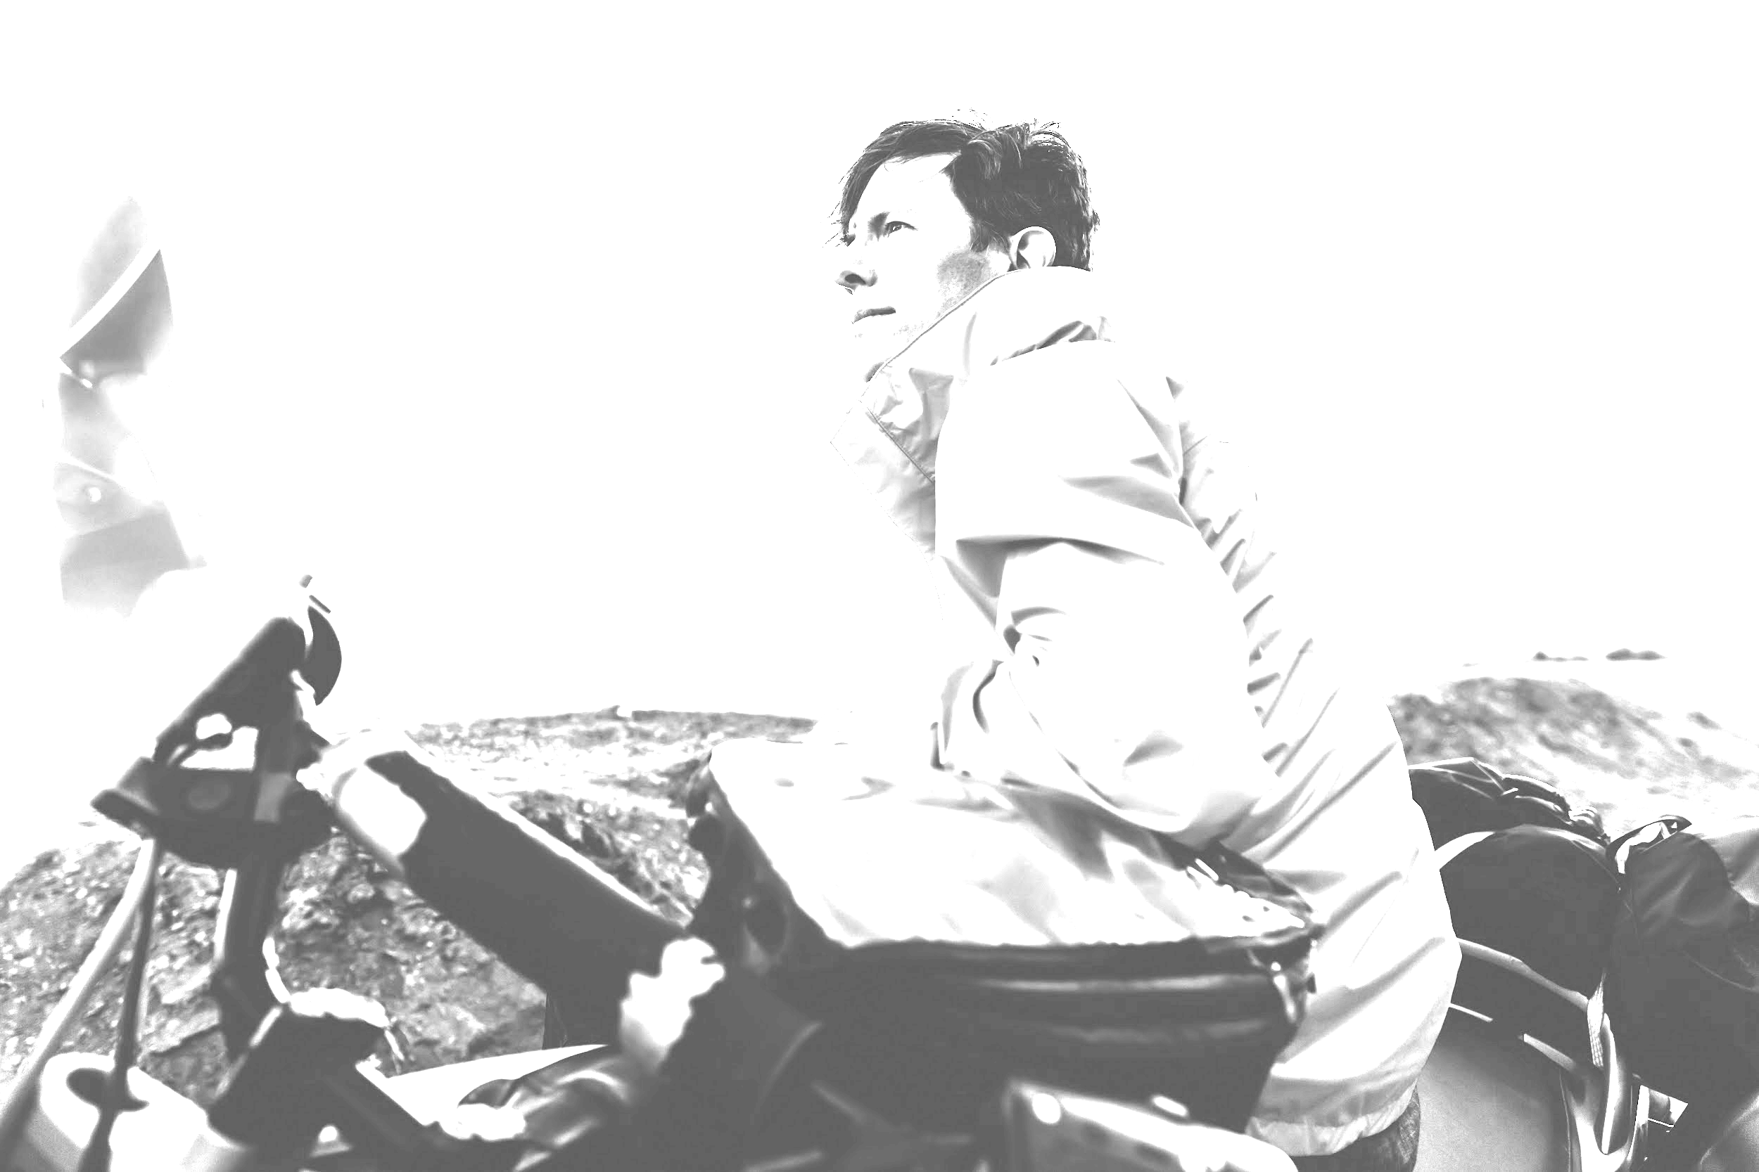
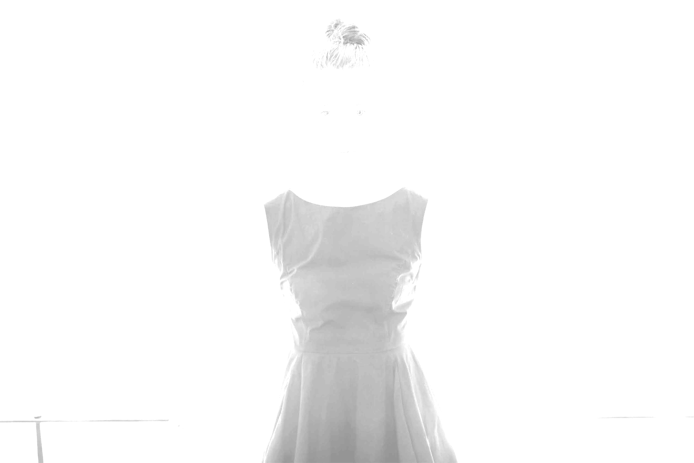
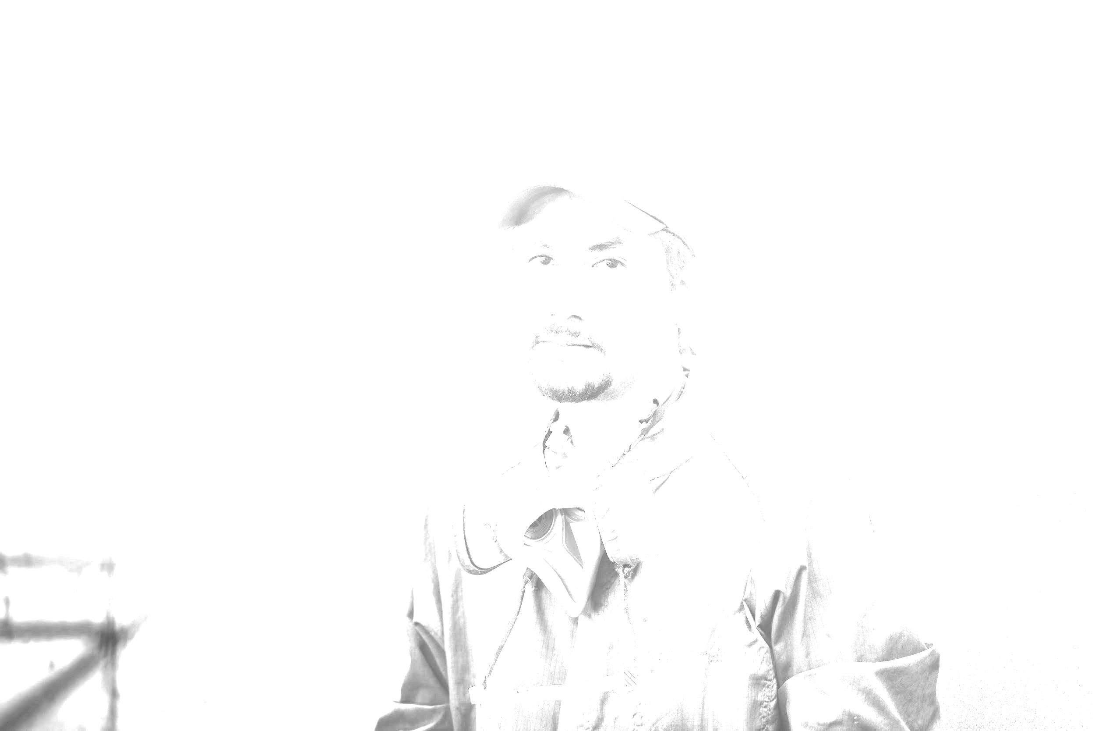
VOC2012 Dataset
The PASCAL Visual Object Classes Challenge 2012 (VOC2012) is a set of images that has an annotation file giving a bounding box and object class label for each object in one of the twenty classes present in the image.

Slide 7
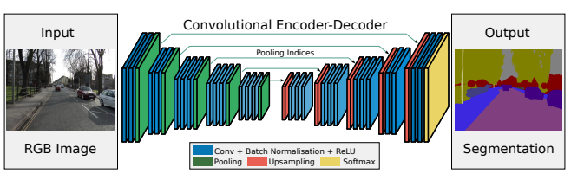
SegNet Architecture
Encoder-Decoder Structure:
Encoder: Topologically identical to the 13 convolutional layers of VGG16 but without fully connected layers, making it lightweight and easier to train.
Decoder: Uses pooling indices from the encoder's max-pooling layers to upsample feature maps, eliminating the need for learning upsampling weights.
Pixel-Wise Classification: A final layer performs pixel-wise classification to assign each pixel to a class label.

Slide 8
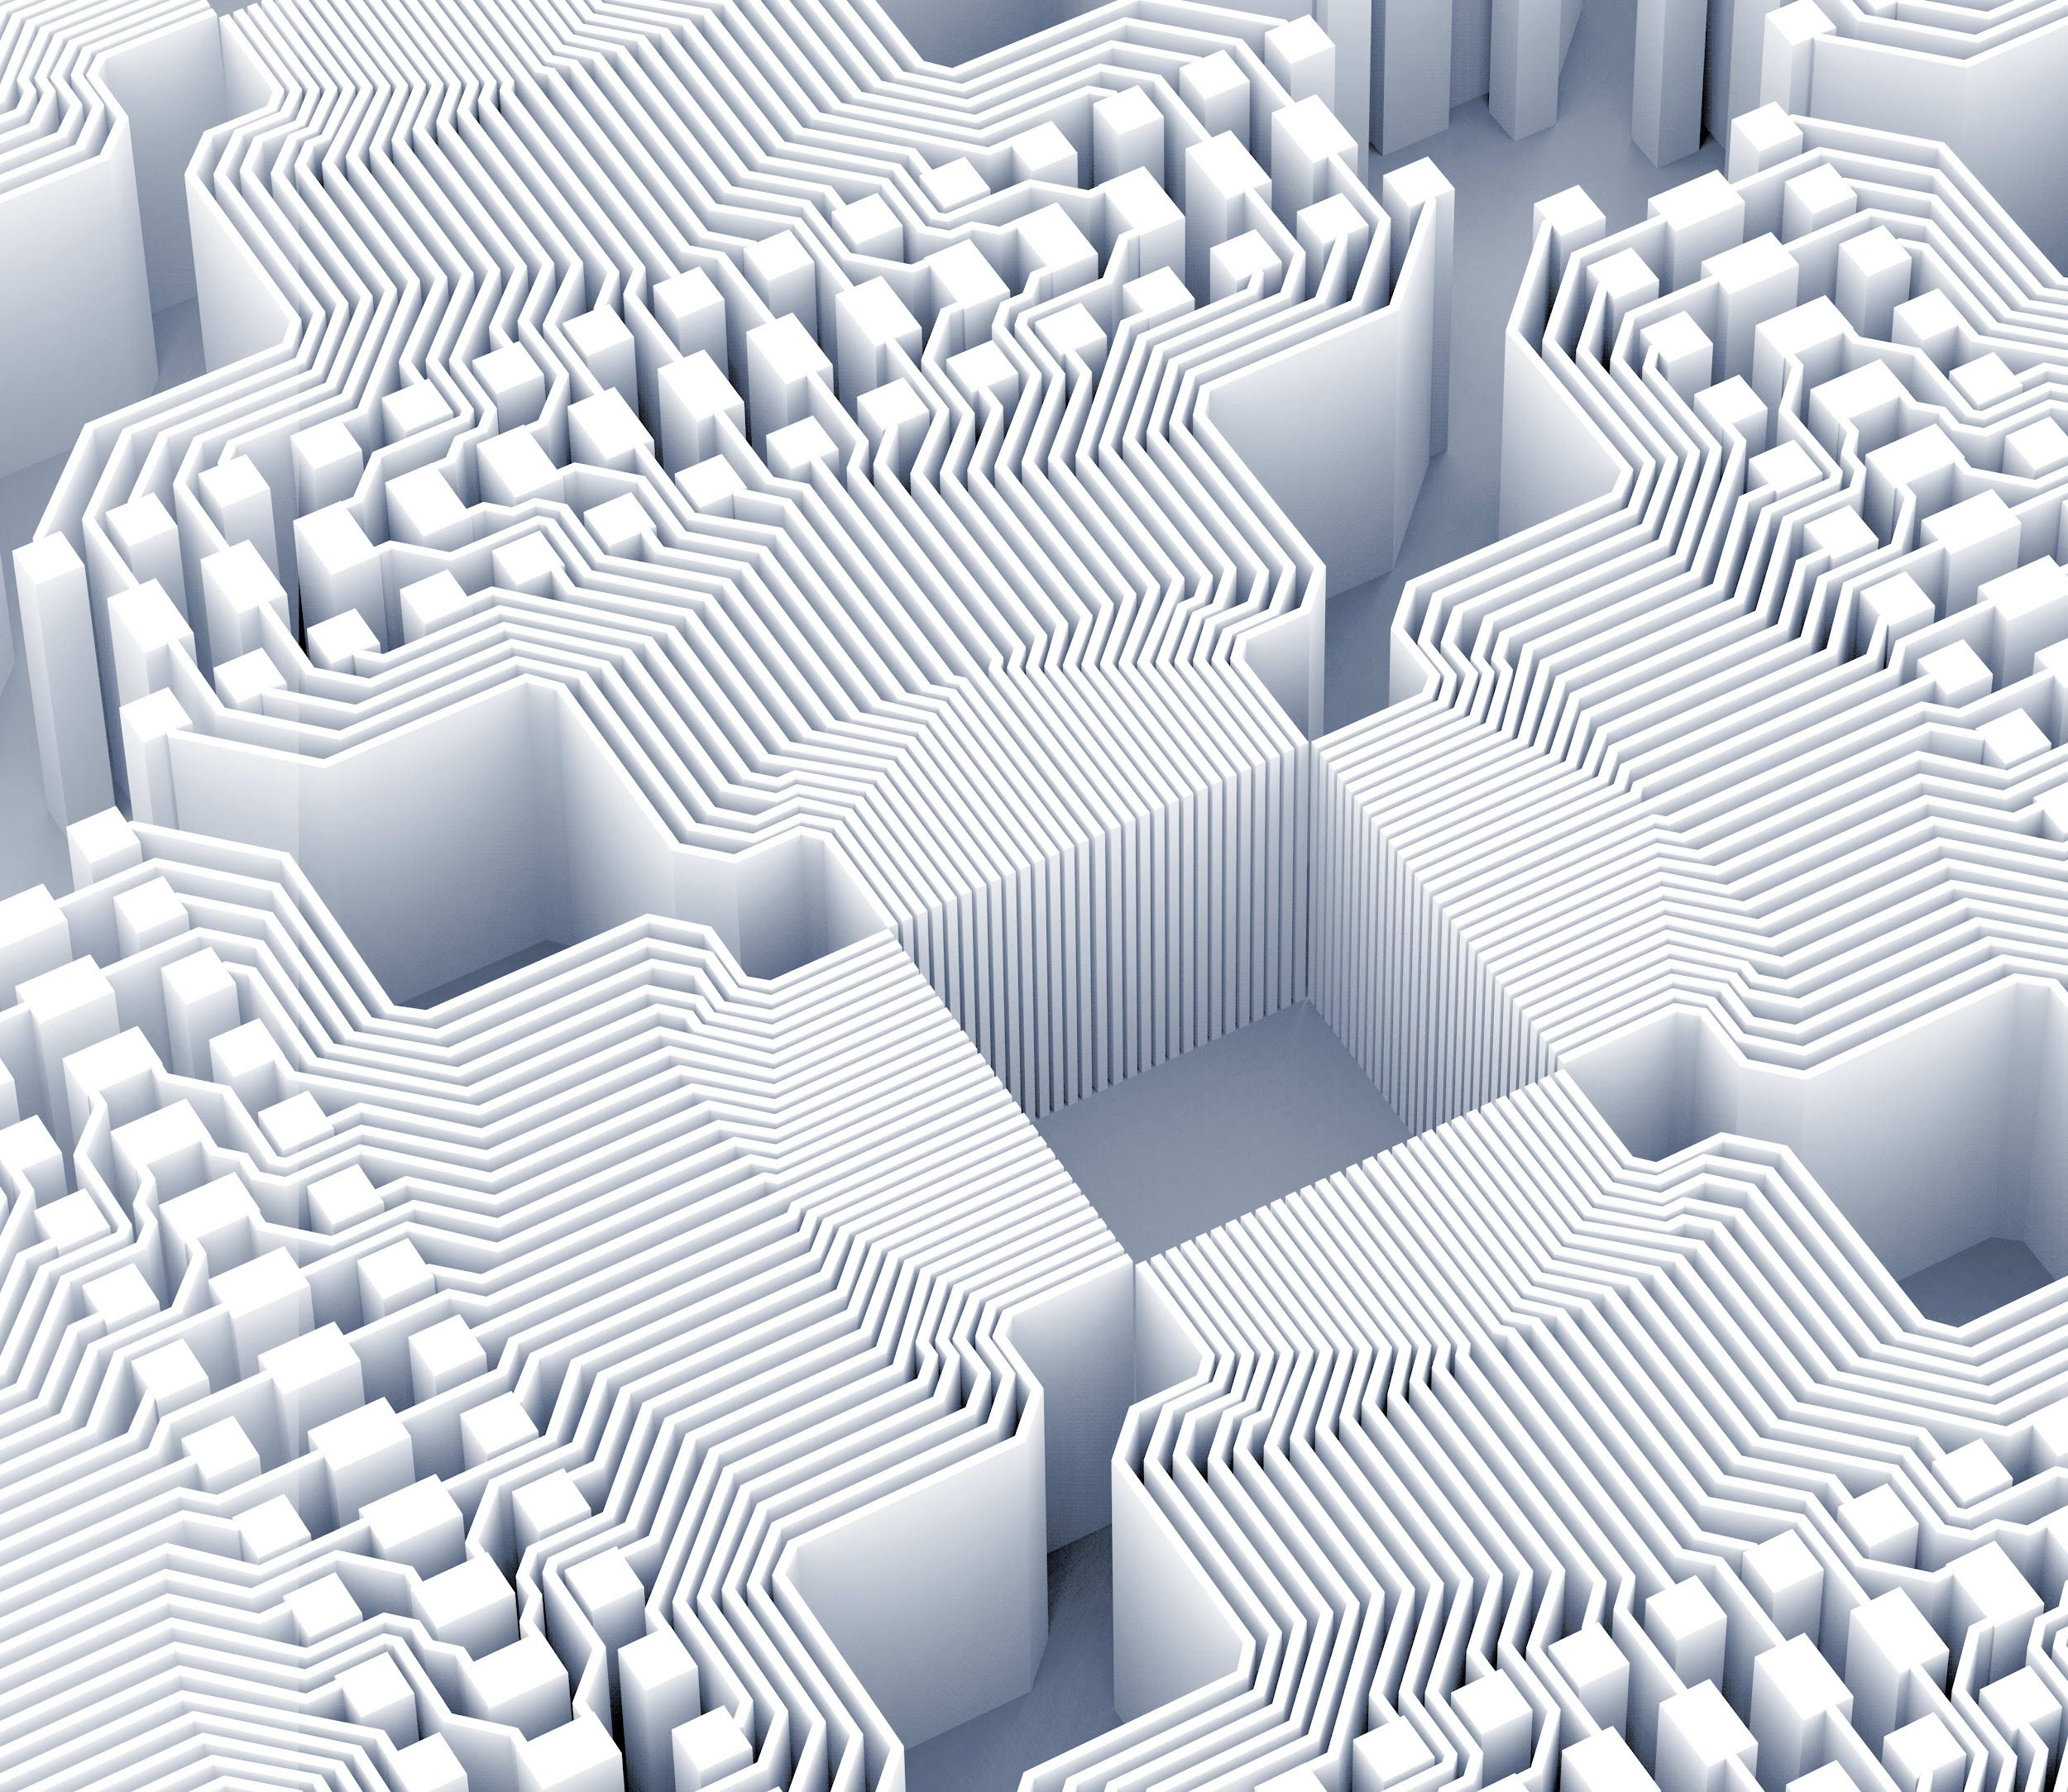
Applying CUDA
To increase performance and reduce training time,
CUDA is utilized for parallel computation, allowing for faster processing of large datasets.
Our implementation is optimized for both memory usage and computational speed, making it suitable for real-time applications.

Slide 9
References
A deep convolutional encoder-decoder architecture for ... (n.d.). http://arxiv.org/pdf/1511.00561
01
Visual object classes challenge 2012 (VOC2012). The PASCAL Visual Object Classes Challenge 2012 (VOC2012). (n.d.). http://host.robots.ox.ac.uk/pascal/VOC/voc2012/
02

Slide 10
Thank you!

